Slide 1
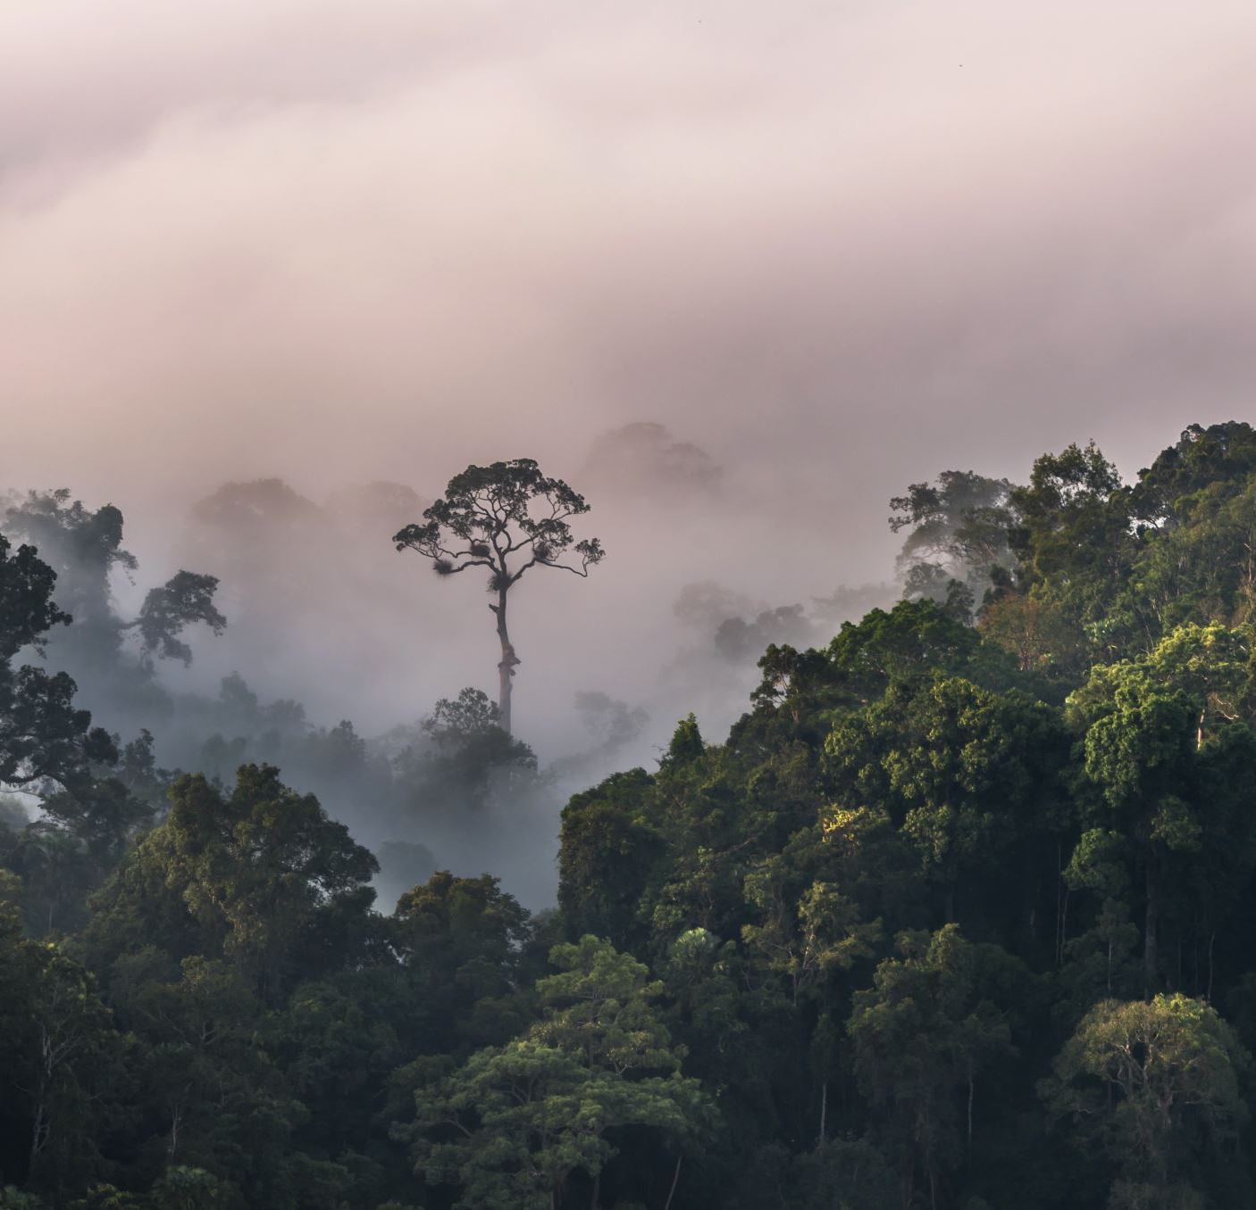
Machine Learning with Audio Review – Animal Classification From Audio
Anton Dzega
Roei Yehezkel
Omri Vilan

Slide 2
Animal Species Classification
Motivation:
The rainforests are large and diverse echo systems home to hundreds of species from multiple families: Aves, Mammalia, Insecta, Amphibia.
Today:
Monitoring and recording of species is done primary by trained human scientists, a method which lacks coverage, efficiency, is costly and dangerous for the people performing it.
Goal:
Scientific organizations have the interest to cover large areas of the rain forests with sensors which allow audio recording and thus monitor animal species across vast areas, follow their migrations and estimate population increase or decrease.
Where AI comes into the picture?
The audio recordings need to be monitored and automatically detect animal vocal sounds, preferably classifying the animal class or specific species to perform effective data mining.

Slide 3
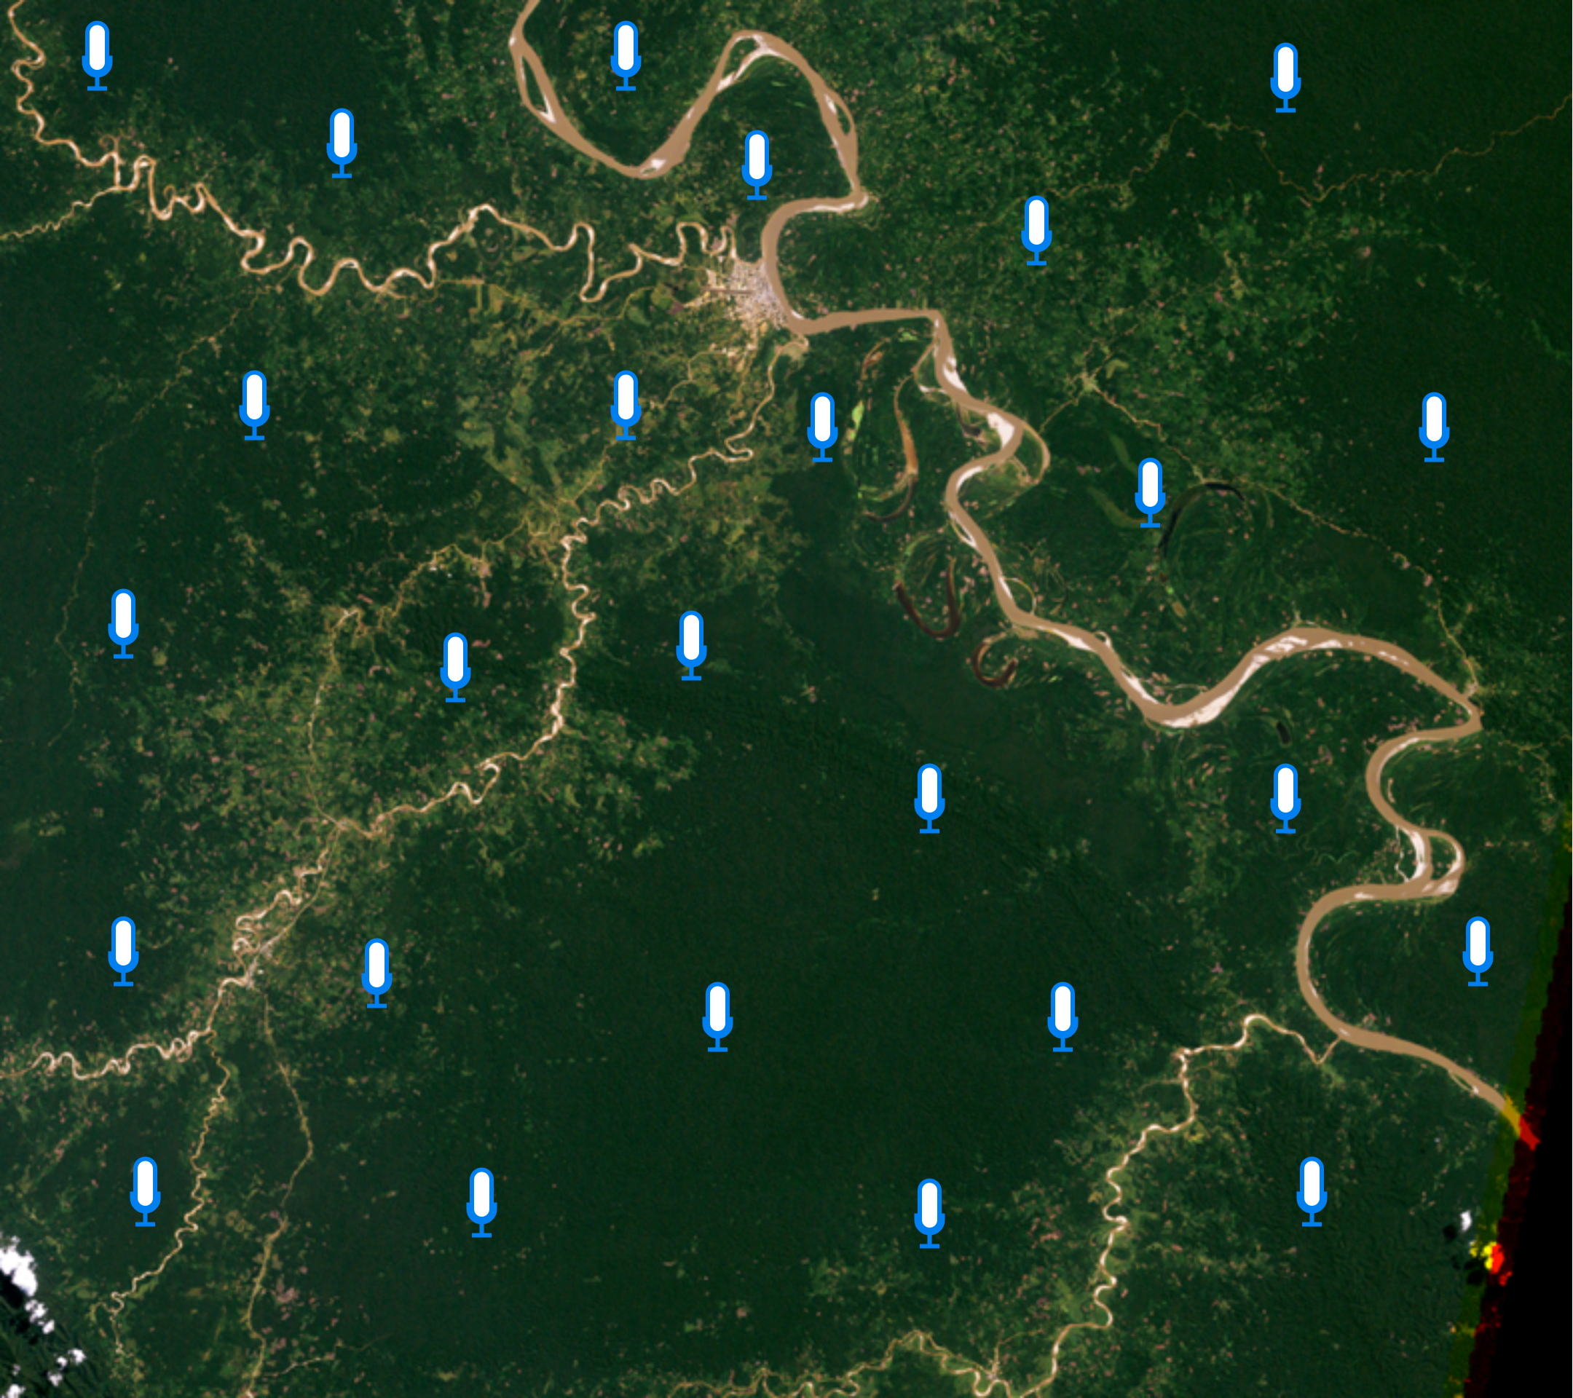
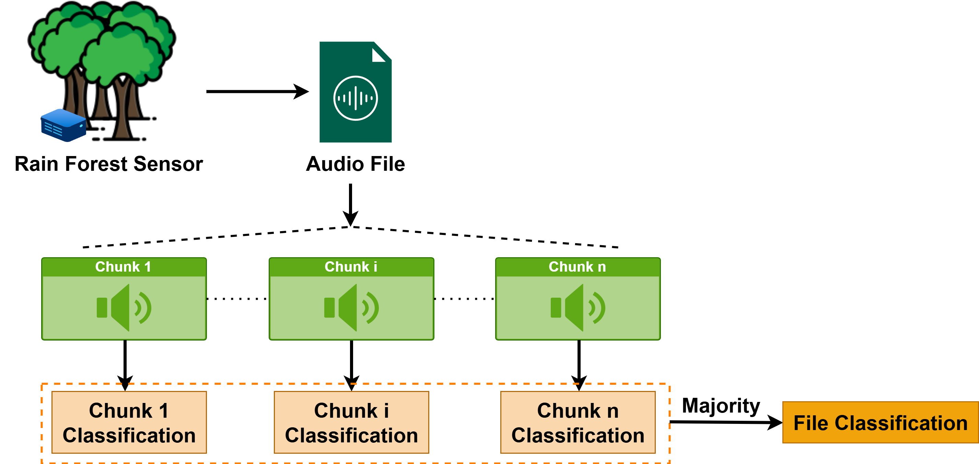
Animal Species Classification – How?
Notes:
Each mic is a sensor in a forest, recording soundscape sounds. With a large sensor coverage like in the motivation image, we can record soundscapes across wide areas, allowing more advanced monitoring of the eco system and behavior of animals.

Slide 4
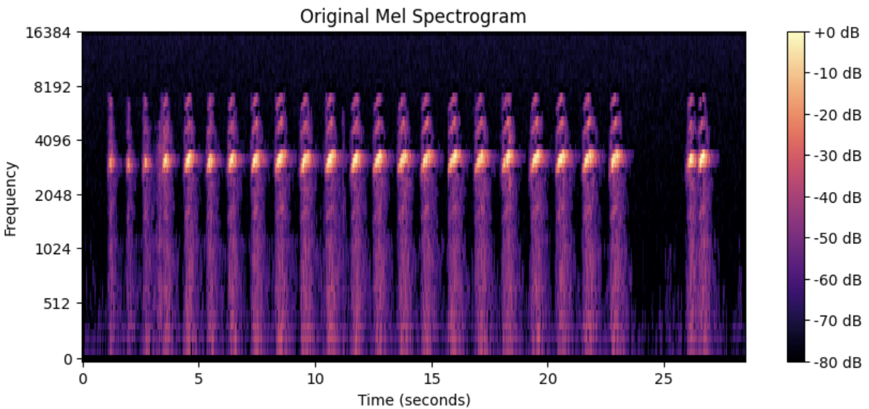
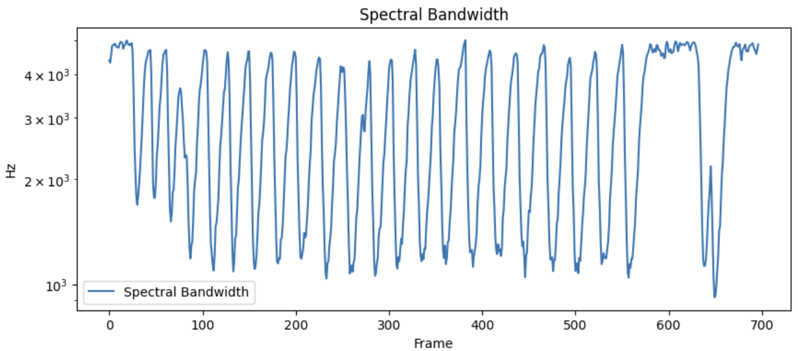
Audio Files & Data Extraction
Time-Frequency Features
These convert audio into 2D representations named suitable for image-based learning.
Models: CNNs / Vision Transformers (ViTs)
Applications:
Transfer Learning
Speech recognition
……
Statistical and Signal-Derived Features
These are numeric vectors per time window (or global file statistics) which allow tabular feature representation:
Models: SVM, XGBoost, GRUs, LSTMs, …
Applications :
Music genre classification
Emotion detection
……
Notes:
Feature extraction from models can be separated into two main approaches:
Structured based features, mosty composed of statistical and signal information.
Image/matrices based features, allowing for the use of advanced models such as CNN based models.

Slide 5
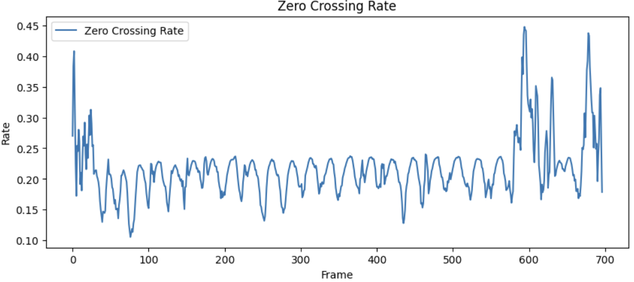
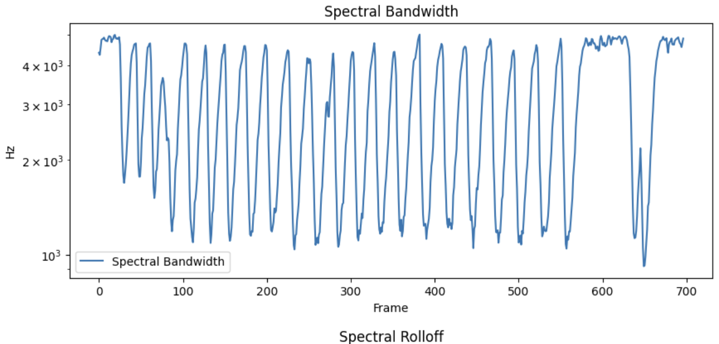
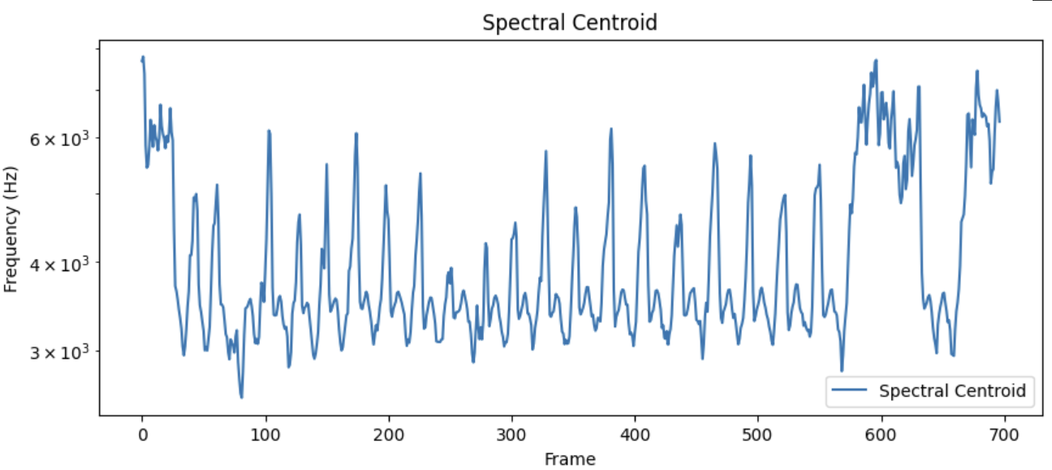
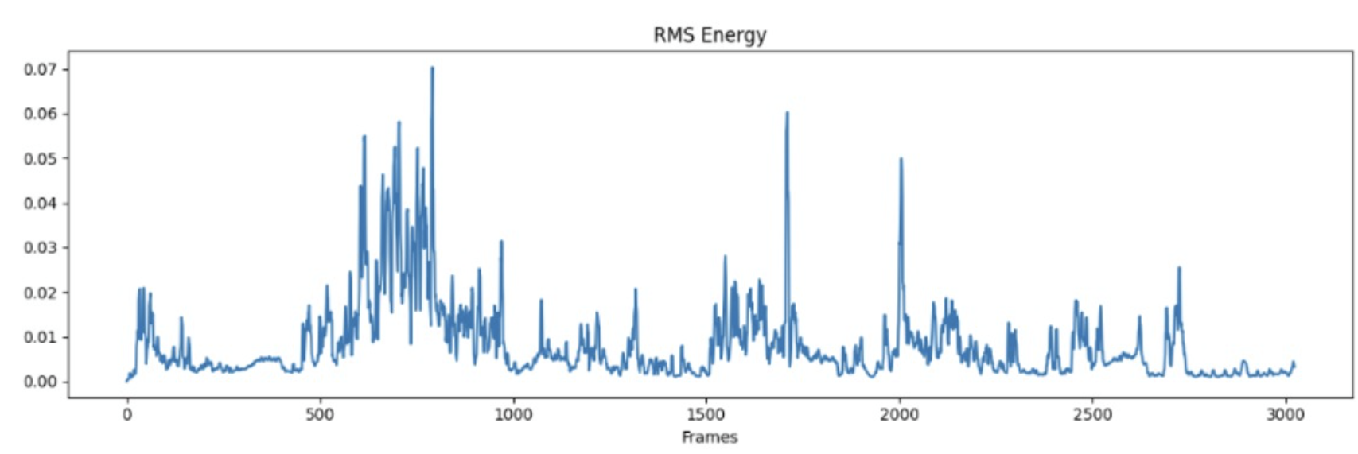
Statistical and Signal-Derived Features
Zero Crossing Rate:
Number of times the signal crosses zero, useful for detecting percussive sounds.
Spectral Centroid:
Indicates where the "center of mass" of the frequency distribution is.
Spectral Bandwidth:
Measures how spread the spectrum is.
Root mean square energy (RMS):
Represents the power of a signal over time. It captures how intense or loud a segment of the audio is.

Slide 6

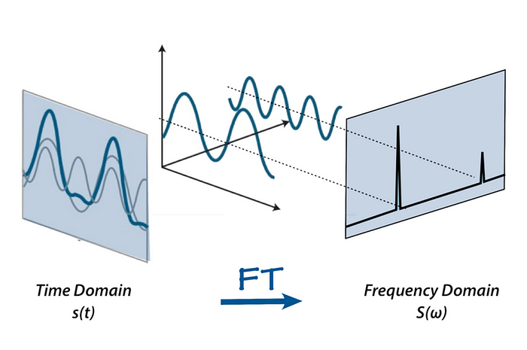
Spectrograms
The Fourier Transform:
An audio signal is comprised of several single-frequency sound waves. The Fourier transform is a mathematical formula that allows us to decompose a signal into it’s individual frequencies and the frequency’s amplitude.
This is possible because every signal can be decomposed into a set of sine and cosine waves that add up to the original signal. This is a remarkable theorem known as Fourier’s theorem.
That’s a beaver

Slide 7
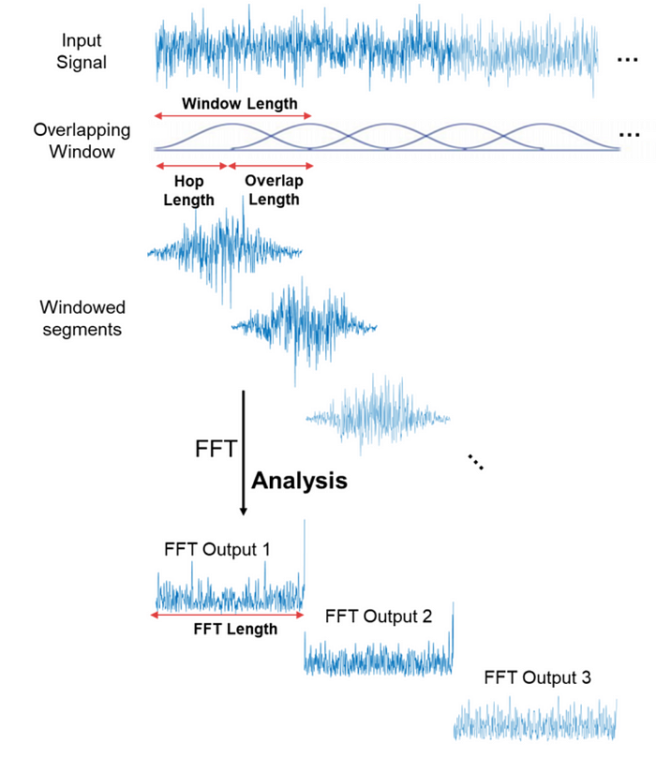
Spectrograms
Fast Fourier Transform (FFT):
The fast Fourier transform (FFT) is an algorithm that can efficiently compute the Fourier transform.
The Spectrogram:
Achieved by computing FFT on overlapping windowed segments of the signal, process called short-time Fourier transform (STFT). It is a way to visually represent a signal’s loudness/amplitude, as it varies over time at different frequencies.
Window Edges Suppression:
When taking a signal window, the start and end may have sudden jumps, causing energy from one frequency to “leak” into others. Solution: Mute the edges
Overlapping Windows:
Required to maintain important transitions between windows. More overlap -> Better Temporal Resolution
Time-Frequency Resolution Tradeoff:
Short windows: good time resolution, poor frequency resolution.
Long windows: good frequency resolution, poor time resolution.

Slide 8
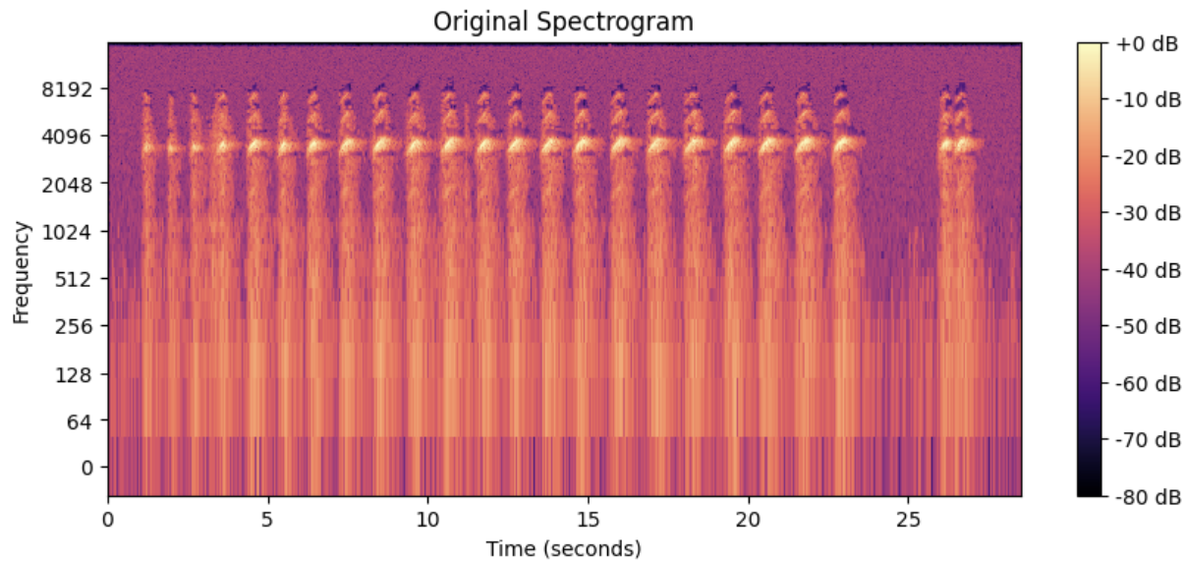
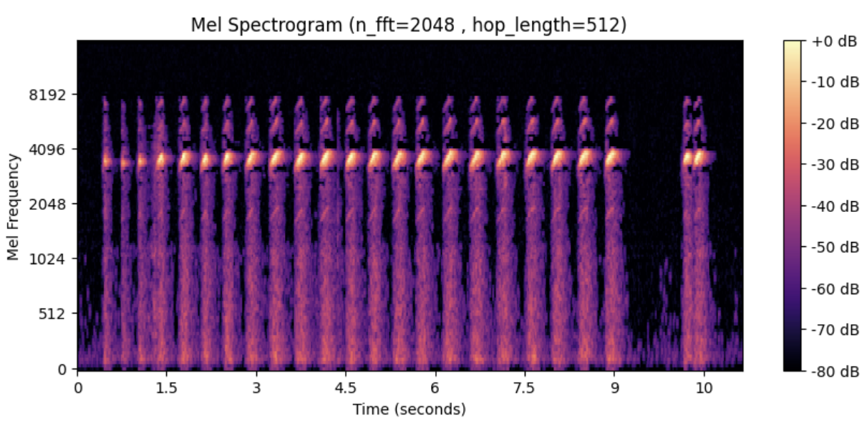
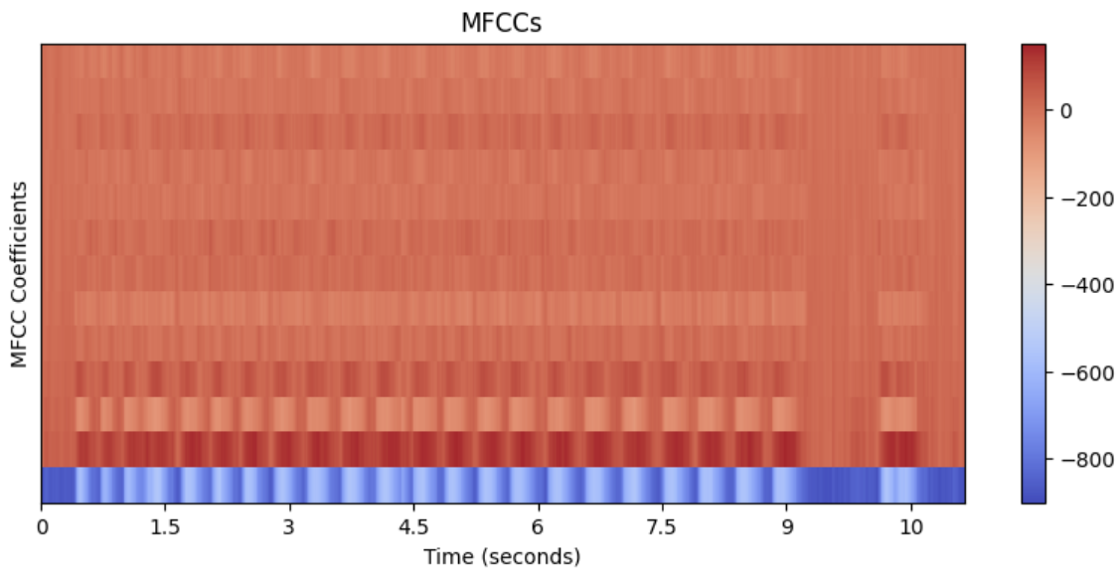
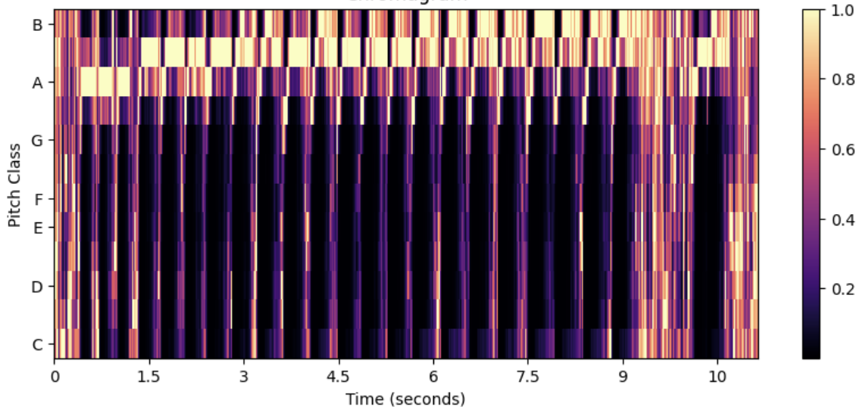
Spectrogram Examples
Complex Spectrogram: General-purpose time-frequency representation.
Mel-Spectrogram: Frequency scale closer to human hearing; commonly used for speech, music, and bioacoustics tasks.
MFCC (Mel-Frequency Cepstral Coefficients: short-term spectral shape of a sound.
Chromagram (Chroma Features): Represents harmonic content, useful in music classification or tonal analysis.

Slide 9
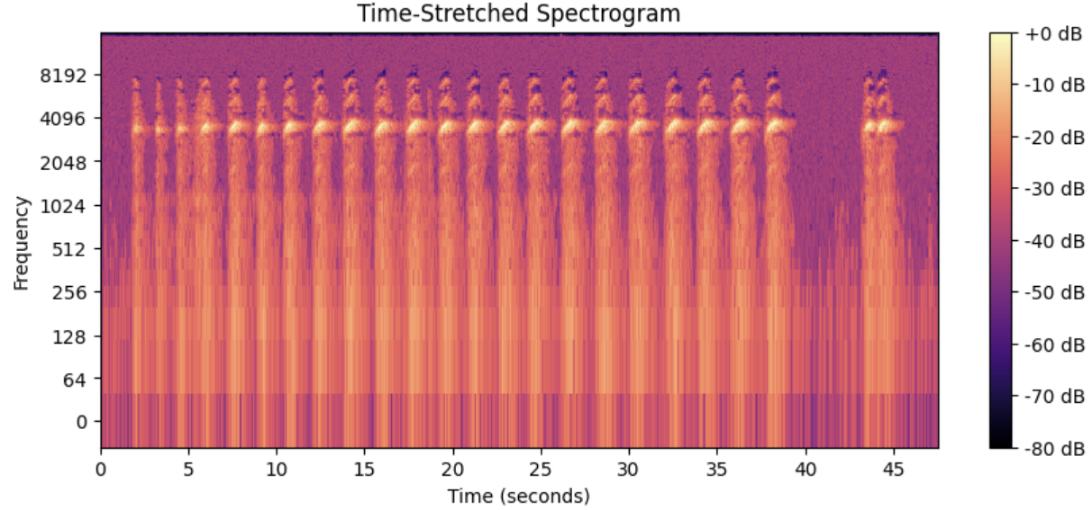
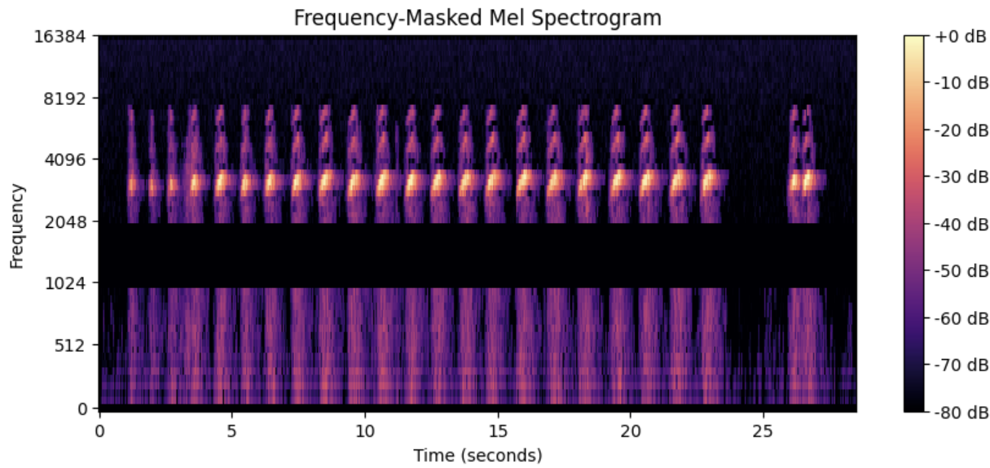
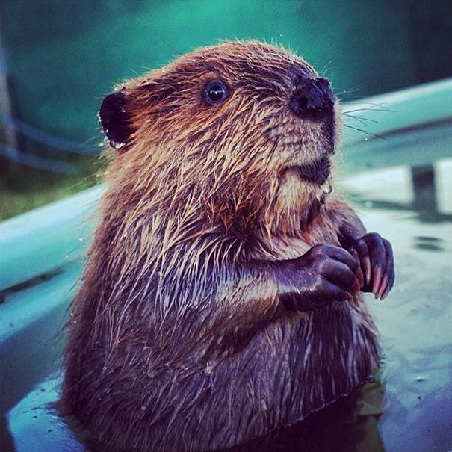
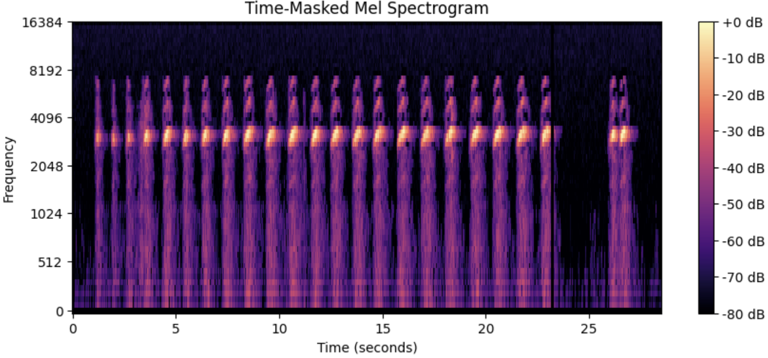
Spectrogram Augmentation
Time Stretch: Stretch audio without changing pitch to create slower/faster audio variations.
Frequency Mask: Randomly masks (removes) up to x frequency bands from the Spectrogram.
Time Mask: Randomly masks (removes) up to x time frames from the Spectrogram.
That’s also a beaver

Slide 10


General Notes on Working With Audio
Main Packages:
When working with audio data, especial in the field of ML, there are two main packages to know and utilize: Librosa and Torchaudio.
Vs

Slide 11
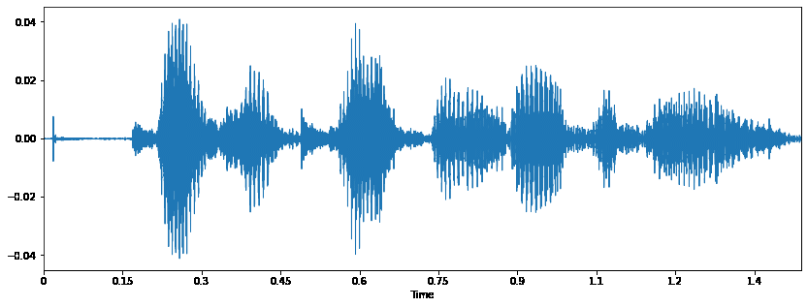
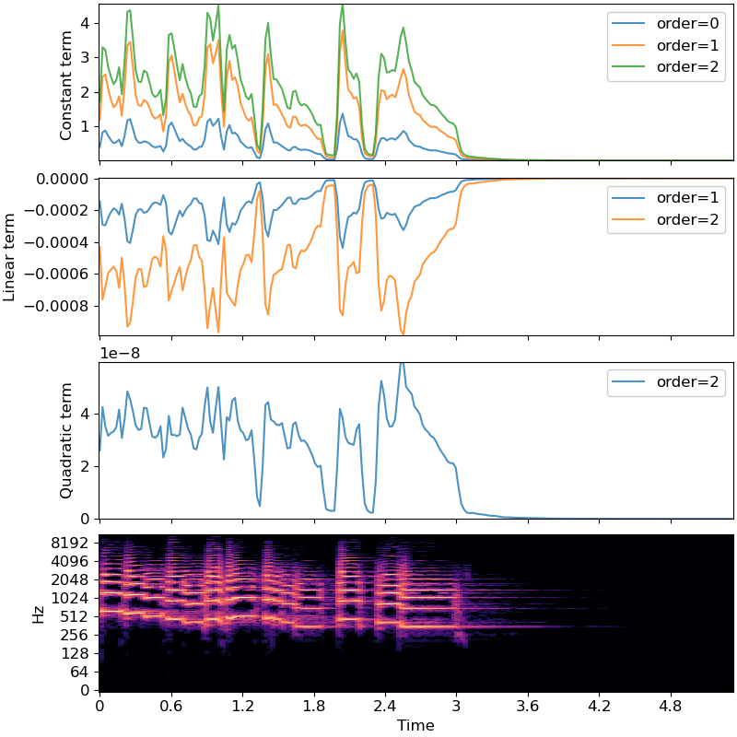
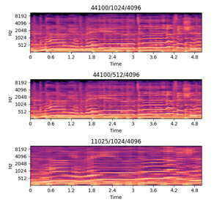
General Notes on Working With Audio
librosa - Python library for music and audio analysis, built on NumPy and SciPy.
Pros:
Easy to use, beginner-friendly.
Extensive support for feature extraction (e.g., MFCC, Chroma, Spectrograms).
Rich visualization tools (e.g., waveforms, spectrograms).
Well-documented and widely adopted in research.
Cons:
Not GPU-accelerated.
Slower for large-scale or real-time processing.
Doesn't integrate tightly with PyTorch pipelines.

Slide 12

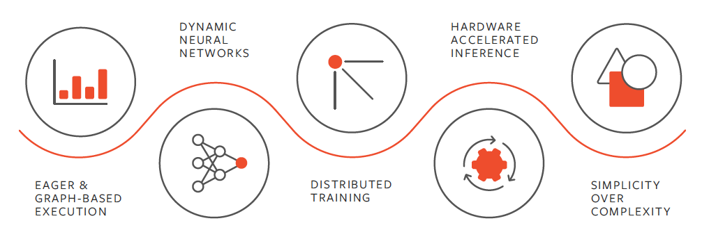
General Notes on Working With Audio
Torchaudio - PyTorch domain library for audio, tightly integrated with the PyTorch ecosystem.
Pros:
Native PyTorch integration (easy for model pipelines).
GPU support and batched processing.
Pre-trained models and datasets available.
More scalable for deep learning.
Cons:
Smaller community and fewer examples than Librosa.
Less intuitive for beginners.
Limited visualization tools (requires external libs).

Slide 13
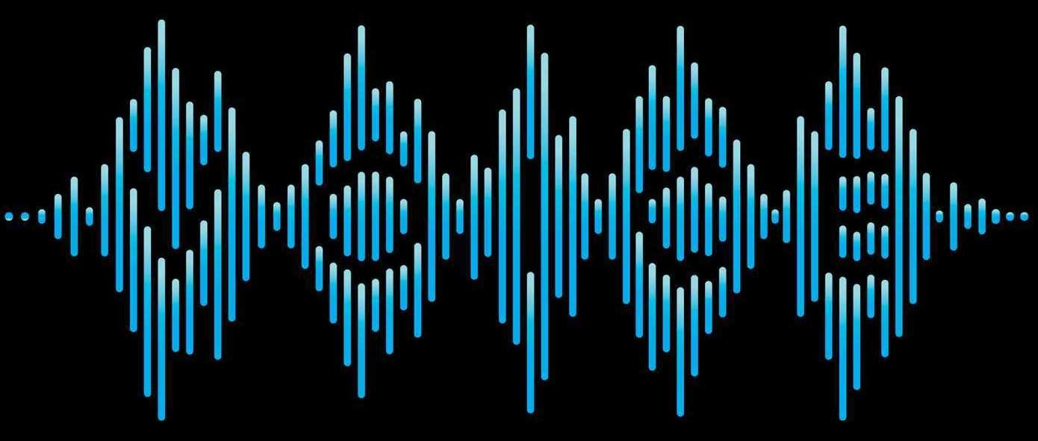
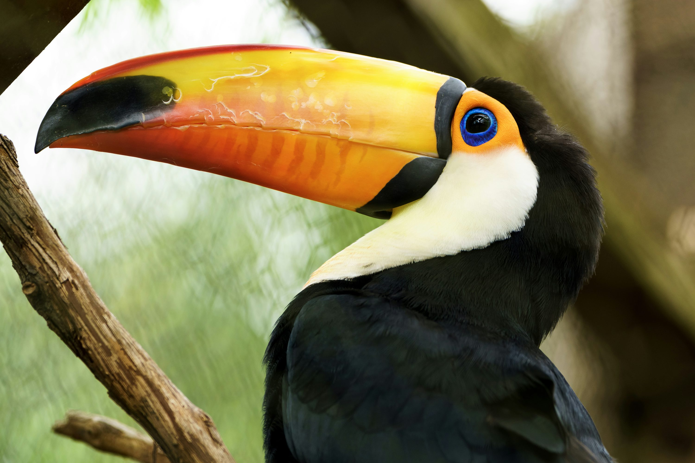
Training Data Problem – Human Speech
Problem:
Most training data audio was recorded by humans randomly speak or provide description for the recording.
Solution Model - Silero VAD :
The Silero VAD (Voice Activity Detector) is a lightweight and efficient model designed to detect human speech in audio recordings.
The model is not open source, but:
Backbone - convolutional neural network (CNN).
The model takes small chunks of audio (~0.5s) and predicts whether speech is present.
Trained on large and diverse dataset of audio recordings, including:
Various languages and accents
Multiple types of background noise (e.g., street noise, music, overlapping speech).
That’s not a beaver
Notes:
In our case, audio files were recorded by humans, resulting in a significant number of recordings containing human voices.
This can negatively affect performance of models which learn to identify animal classes based on audio.
To handle this, Silero VAD is used due to its ability to identify human speech timestamps, allowing filtering and removal of such segments.

Slide 14
Animal Species Classification – How?
Notes:
Each mic is a sensor in a forest, recording soundscape sounds. Common approach for audio file classification:
Each audio file is broken into segments (5 seconds in our case), each such is then used to extract audio features (spectrograms in our case) which are then fed trough a model which performs segment classification. Finally, the entire file is classified to the classification that most chunks were classified to.

Slide 15
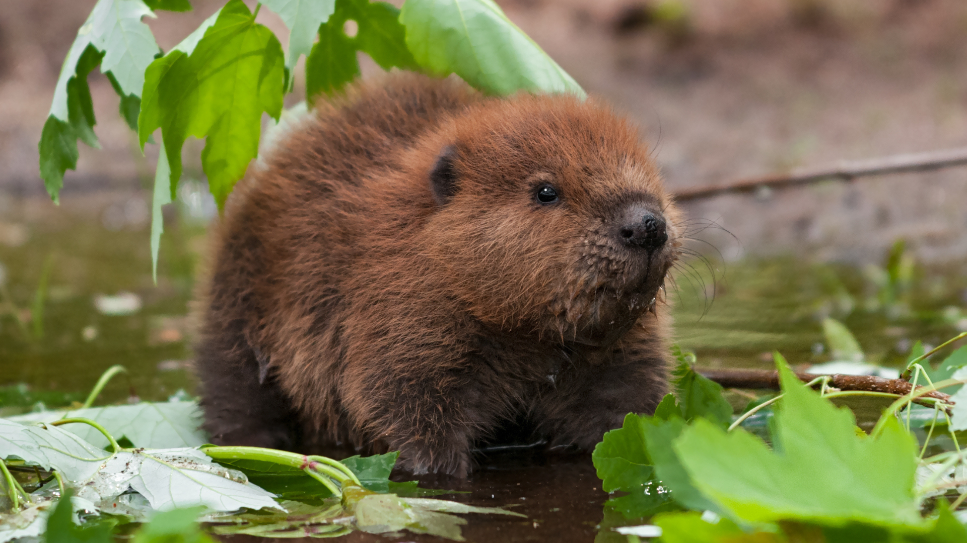
Thank You

